Slide 1

Understanding API Gateway in Java
Your First Steps into Microservices Architecture

Slide 2

What is an API Gateway?
The Front Door Concept
Single entry point for all client requests
Routes traffic to correct microservices
Hides backend complexity from clients
Manages communication patterns
Solves "spaghetti" architecture problems
Think Like a Hotel Receptionist
Guests ask for Room 101 → Receptionist directs, handles check-in, manages everything seamlessly

Slide 3




How Traffic Flows Through Gateway
Client Request
API Gateway
Microservices
Mobile app, web browser, or external service sends request
Routes, authenticates, and processes the request
Independent services handle specific business logic

Slide 4
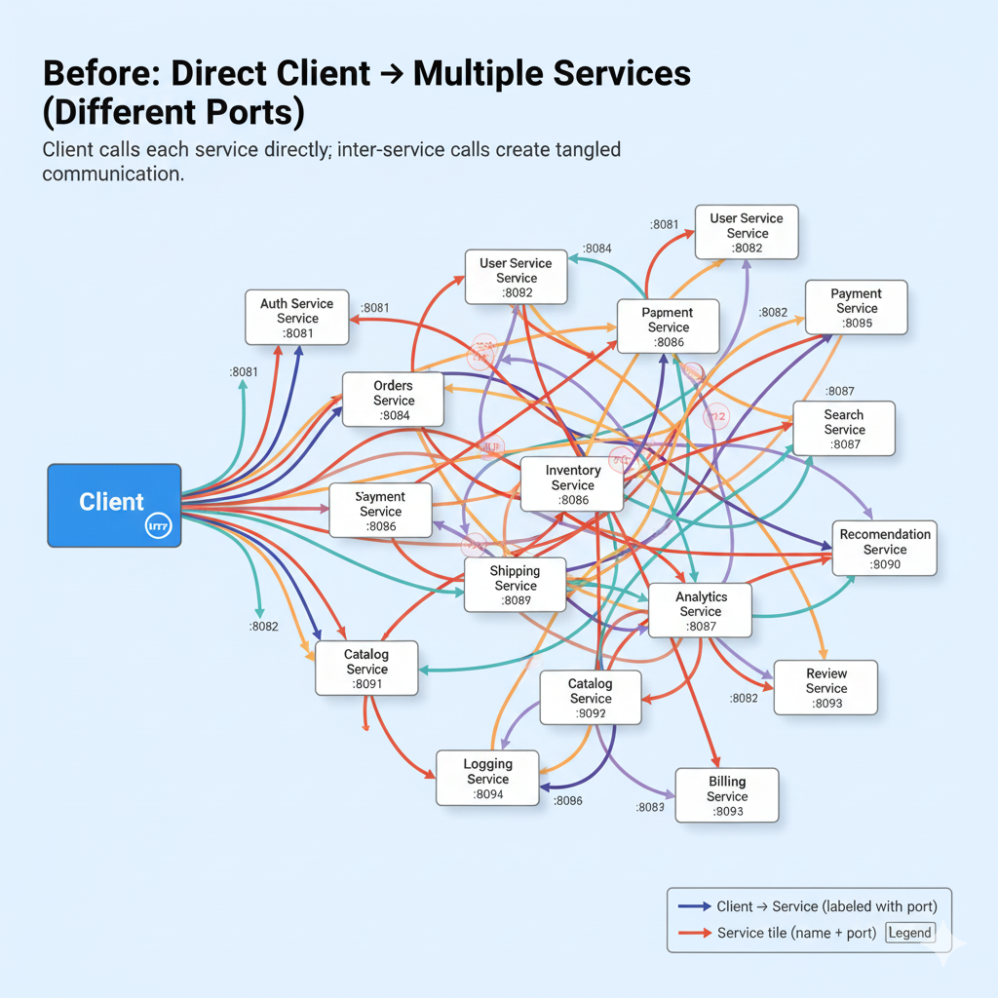

Slide 5
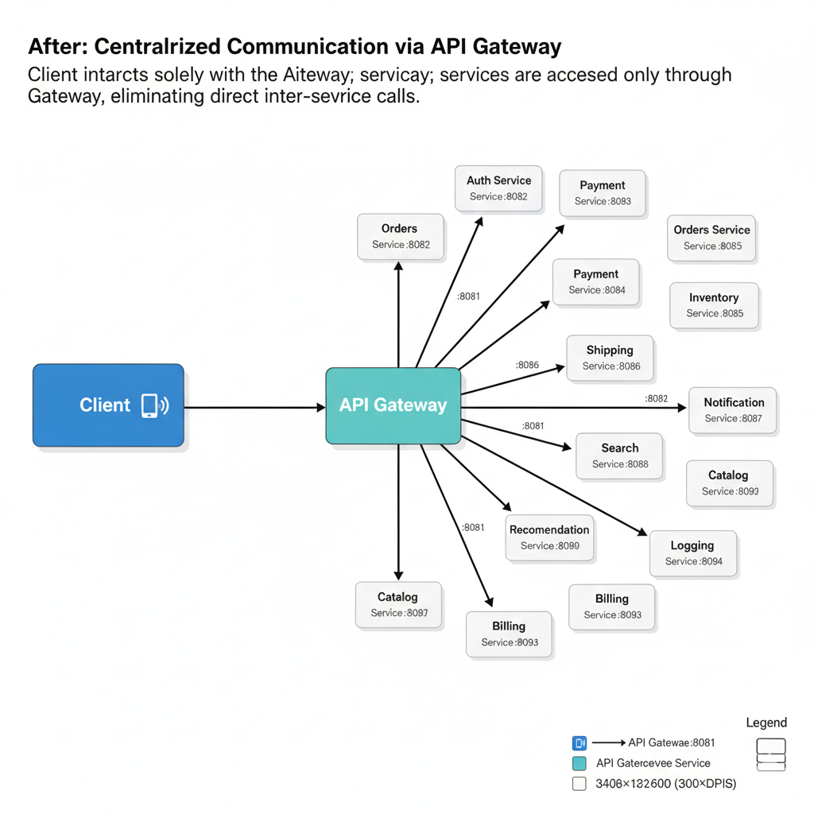

Slide 6






Why bother API Gateway?
Security
Centralised authentication with JWT tokens
Single authorisation point for all services
Load Balancing
Distributes traffic evenly
Prevents service overload
Rate Limiting
Controls request frequency
Prevents spam attacks
Monitoring
Centralised logging for debugging
Easy traffic analysis
Without gateway: chaos! With gateway: organised traffic management

Slide 7

Building It in Java: Your Tech Stack
01
Choose Your Framework
Spring Cloud Gateway – Modern, reactive, non-blocking
02
Add Dependencies
Include spring-cloud-starter-gateway in your pom.xml file
03
Configure Routes
Define routing rules in application.yml configuration file
04
Apply Filters
Add custom logic for authentication, logging, transformation

Slide 8

Simple Configuration Example
Routing users service requests
spring:
cloud:
gateway:
routes:
- id: user-service
uri: http://localhost:8081
predicates:
- Path=/users/**
1
Client Request
GET /users/123
2
Gateway Matches
Path predicate: /users/**
3
Routes To
localhost:8081
4
Returns Response
User data back to client

Slide 9

Key Takeaways & Next Steps
Gateway = Your Traffic Manager
Spring Cloud Makes It Easy
Single entry point for routing, security, and intelligent request handling in microservices
Start with simple route configuration, then level up with custom filters and advanced features
Real Benefits for Your Projects
Faster deployments, safer applications, easier scaling for team projects
Ready to Practice?

